Slide 1

10: Evolutionary Games
Games People Play.

Slide 2
Evolutionary Games
What if individuals aren’t as smart and calculating as we have assumed so far?
Perhaps decision making is simpler
  Good decisions and decision makers persist and are copied
  Bad decisions and decision makers die out!!
  Natural selection makes the decisions
This is the idea behind evolutionary game theory
Games People Play.

Slide 3
Evolutionary Games
Genotype – the genetic type of a player
Phenotype – the behavior of a genotype
Fitness – a measure of the success of a phenotype
Selection – successful genotypes out-reproduce unsuccessful ones
Mutations – random creation of new genotypes
Invasion – mutations that successfully out-compete the current genotypes and increase in number
Evolutionary stability – a population of genotypes that cannot be successfully invaded
Games People Play.

Slide 4
The prisoners dilemma as an evolutionary game
2 genotypes
  Cooperators (C-types) – always cooperate
  Defectors (D-types) - always defect
Pairs of players are matched at random
  A cooperator can be matched with another cooperator or with a defector and vice versa.
Games People Play.

Slide 5
The prisoners dilemma as an evolutionary game
The payoff matrix
Suppose that the proportions of cooperators and defectors in the population are initially x and 1-x respectively.
 |  | Column
 |  | Cooperate | Defect
Row | Cooperate | 12,12 | 1, 25
 | Defect | 25,1 | 3,3
Games People Play.

Slide 6
The prisoners dilemma as an evolutionary game
Fitness levels
A cooperator meets another cooperator with probability x and a defector with probability 1-x and expects to earn
    F(c) = x(12) + (1-x)(1)
A defector will also meet a cooperator with probability x and a defector with probability 1-x and expects to earn
    F(d) = x(25) + (1-x)(3)
 |  | Column
 |  | Cooperate | Defect
Row | Cooperate | 12,12 | 1, 25
 | Defect | 25,1 | 3,3
Games People Play.

Slide 7
The prisoners dilemma as an evolutionary game
Selection
  The cooperators will outbreed the defectors if
  F(C) > F(D)
  x(12) + (1-x)(1) > x(25) + (1-x)(3)
  So the cooperators will outbreed the defectors if x < - (2/11)
  Which cannot hold.
  So the cooperators will die out!!!
100% defectors is an Evolutionary Stable State.
Games People Play.

Slide 8
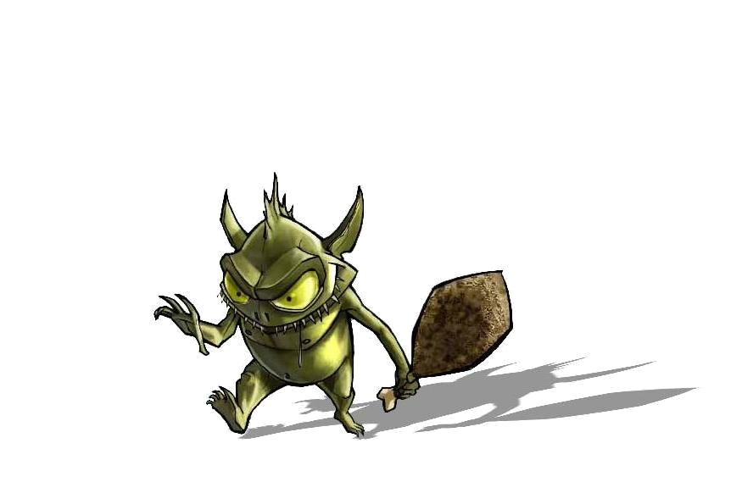
The prisoners dilemma as an evolutionary game
Mutation
  Suppose now a mutation occurs and a third genotype that plays tit-for-tat appears.
  Also suppose that each pair of players plays each other three times.
  Assume a T-type always plays cooperate on the first round.
Can the mutation successfully invade?
Games People Play.

Slide 9
The prisoners dilemma as an evolutionary game
If a defector meets a defector we get
        Round #1
        Round #2
        Round #3
 |  | Defector
 |  | Cooperate | Defect
Defector | Cooperate | 12,12 | 1,25
 | Defect | 25,1 | 3,3
 |  | Defector
 |  | Cooperate | Defect
Defector | Cooperate | 12,12 | 1,25
 | Defect | 25,1 | 3,3
 |  | Defector
 |  | Cooperate | Defect
Defector | Cooperate | 12,12 | 1,25
 | Defect | 25,1 | 3,3
Games People Play.

Slide 10
The prisoners dilemma as an evolutionary game
So each defector that meets another defector enjoys a fitness of 9
Games People Play.

Slide 11
The prisoners dilemma as an evolutionary game
If a defector meets a tit-for-tat we get
        Round #1
        Round #2
        Round #3
 |  | Defector
 |  | Cooperate | Defect
Tit-for-tat | Cooperate | 12,12 | 1,25
 | Defect | 25,1 | 3,3
 |  | Defector
 |  | Cooperate | Defect
Tit-for-tat | Cooperate | 12,12 | 1,25
 | Defect | 25,1 | 3,3
 |  | Defector
 |  | Cooperate | Defect
Tit-for-tat | Cooperate | 12,12 | 1,25
 | Defect | 25,1 | 3,3
Games People Play.

Slide 12
The prisoners dilemma as an evolutionary game
If a defector meets a tit-for-tat
  The tit-for-tat enjoys a fitness of 7
  The Defector enjoys a fitness of 31
Games People Play.

Slide 13
The prisoners dilemma as an evolutionary game
If a tit-for-tat meets a tit-for-tat we get
        Round #1
        Round #2
        Round #3
 |  | Tit-for-tat
 |  | Cooperate | Defect
Tit-for-tat | Cooperate | 12,12 | 1,25
 | Defect | 25,1 | 3,3
 |  | Tit-for-tat
 |  | Cooperate | Defect
Tit-for-tat | Cooperate | 12,12 | 1,25
 | Defect | 25,1 | 3,3
 |  | Tit-for-tat
 |  | Cooperate | Defect
Tit-for-tat | Cooperate | 12,12 | 1,25
 | Defect | 25,1 | 3,3
Games People Play.

Slide 14
The prisoners dilemma as an evolutionary game
If a tit-for-tat meets a tit-for-tat
  Both tit-for-tats enjoy a fitness of 36
Games People Play.

Slide 15
The prisoners dilemma as an evolutionary game
So we know
  Defector meets defector
    Both receive a fitness of 9
  Defector meets a tit-for-tat
    Defector receives a fitness of 31
    Tit-for-tat receives a fitness of 7
  Tit-for-tat meets a tit-for-tat
    Both receive a fitness of 36.
Games People Play.

Slide 16
The prisoners dilemma as an evolutionary game
Conclusions结论有问题 不看
  There are two evolutionary stable steady states
    A tit-for-tat cannot invade a population of defectors
    A defector cannot invade a population of tit-for-tats
  If both types initially exist in the population which ESS arises depends on their initial relative numbers.
  History matters
Games People Play.

Slide 17
Colonel Blotto Game
 |  | Battlefield
Team Name |  | 1 | 2 | 3 | 4 | 5 | 6 | 7 | 8 | 9 | 10
 | Hold Up Guys | 3 | 3 | 56 | 3 | 12 | 3 | 3 | 57 | 57 | 3
 | Window Shoppas | 36 | 26 | 26 | 36 | 2 | 5 | 2 | 36 | 5 | 26
 | Wasted Potential | 50 | 5 | 10 | 10 | 10 | 50 | 0 | 10 | 5 | 50
 | Cemetery Scuba Squad | 6 | 0 | 4 | 6 | 34 | 36 | 34 | 34 | 34 | 12
 | Sarah Palin Wannabes | 33 | 0 | 34 | 1 | 33 | 0 | 33 | 0 | 33 | 33
 | Zoo | 0 | 1 | 33 | 33 | 33 | 33 | 0 | 33 | 33 | 1
 | Unemployed Pixies | 35 | 5 | 5 | 5 | 35 | 35 | 35 | 5 | 35 | 5
 | Conquistadors | 32 | 1 | 1 | 32 | 1 | 33 | 1 | 33 | 33 | 33
 | Dundermifflin | 29 | 0 | 29 | 28 | 0 | 28 | 28 | 28 | 0 | 30
 | Bush Lovers | 0 | 0 | 0 | 0 | 34 | 34 | 33 | 33 | 33 | 33
Games People Play.

Slide 18
Colonel Blotto Game Results
 | HUG | WS | WP | CSS | SPW | Z | UP | C | D | BL | Total
Hold Up Guys |  | 4-6 | 5-5 |  |  |  |  |  |  | 6-4 | 1.5
Window Shoppas | 6-4 |  | 5-4 | 6-4 |  |  |  |  |  |  | 3.0
Wasted Potential | 5-5 | 4-5 |  | 6-4 |  |  |  |  |  |  | 1.5
Cemetery Scuba Squad |  | 4-6 | 4-6 |  | 3-6 |  |  |  |  |  | 0.0
Sarah Palin Wannabes |  |  |  | 6-3 |  | 4-4 | 2-8 |  |  |  | 1.5
Zoo |  |  |  |  | 4-4 |  | 3-7 |  | 7-3 |  | 1.5
Unemployed Pixies |  |  |  |  | 8-2 | 7-3 |  | 7-3 |  |  | 3.0
Conquistadors |  |  |  |  |  |  | 3-7 |  | 8-2 | 4-3 | 2.0
Dundermifflin |  |  |  |  |  | 3-7 |  | 2-8 |  | 3-6 | 0.0
Bush Lovers | 4-6 |  |  |  |  |  |  | 3-4 | 6-3 |  | 1.0
Games People Play.

